Slide 1
Topic Name Research Report
Name Tahir Ali
Roll No. 131
Section C
Lecturer Name Maam Rabia Rehman

Slide 2
Writing a Research Report
If research was not “written up,” did it really occur?

Slide 3
Writing a Research Report
Academic sociologists conduct research to discover facts, truths, and explanations about the social world.
They write research reports to convey theirs and others’ research findings.
The point is to provide useful information to others.
Library research refers to gathering information that others have generated.
Primary research refers to generating information through data collection, analysis, and reporting findings.

Slide 4
Writing a Research Report
Sociologists’ articles, papers, or research reports convey:
  Facts and/or theories others in the research community generated (research reviews)
  Facts and/or theories the research community generated and one’s own findings generated from a research project (research article or book)
  And rarely, only one’s findings generated from a research project (applied research)

Slide 5
Writing a Research Report
A sociological article, paper, or report generally covers only one important topic of interest and conveys evidence and interpretations of evidence.
Research reports are NOT creative writing, opinion pieces, poems, novels, letters, musings, memoirs, or interesting to read.

Slide 6
What do sociologists do?
Answer People’s Questions
  How extensive is illicit immigration?
  Does the “welfare to work” program work?
Describe social world
Generate and test theories or explanations about the social world
Use sociological knowledge to guide policies

Slide 7
So when sociologists write, they:
State why the research is so important sociologically.
They only make claims that are backed empirical evidence.
They document carefully sources of ideas and claims.
They are extremely descriptive, impersonal, and matter-of-fact.

Slide 8
Writing a Research Report
A sociological article, paper, or report generally takes a structure or form that seems difficult but is intended to help make reading it or using it for research quick and efficient.
A research report has seven components:
  Abstract or Summary
  Introduction
  Review of Literature
  Methods
  Results
  Conclusions and Discussion
  References
Note: Qualitative research reports will vary from what is presented here.

Slide 9
Writing a Research Report
A research report has seven components:
  Abstract or Summary
  The abstract or summary tells the reader very briefly what the main points and findings of the paper are.
  This allows the reader to decide whether the paper is useful to them.
  Get into the habit of reading only abstracts while searching for papers that are relevant to your research.
  Read the body of a paper only when you think it will be useful to you.

Slide 10

Writing a Research Report
  1. Abstract or Summary—an example

Slide 11
Writing a Research Report
  Introduction
  The introduction tells the reader what the topic of the paper is in general terms, why the topic is important, and what to expect in the paper.
  Introductions should funnel from general ideas to the specific topic of the paper
  Introductions are sometimes folded into literature reviews

Slide 12
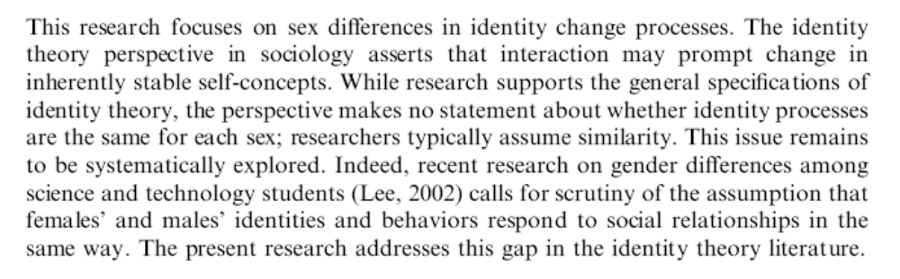
Writing a Research Report
  2. Introduction—an example

Slide 13
Writing a Research Report
  Review of Literature
  The literature review tells the reader what other researchers have discovered about the paper’s topic or tells the reader about other research that is relevant to the topic.
  A literature review should shape the way readers think about a topic—it educates readers about what the community of scholars says about a topic and its surrounding issues.
  Often what students call a “research paper” is merely a review of literature.
  Along the way it states facts and ideas about the social world and supports those facts and ideas with credit for where they came from.

Slide 14
Writing a Research Report
  Review of Literature
  If an idea cannot be substantiated by the community of scholars, the literature review makes clear that the author is speculating, and the logic of the speculation is detailed.
  Irrelevant information is not discussed.
  The literature review has its own voice. The sources of information are not extensively quoted or “copied and pasted.” Instead, the author puts facts and ideas into his or her own words while pointing out where the information came from.
  Think about how you tell family members about the exciting things you learned in classes…or think about how you discuss sociology at cocktail parties. You make claims in you own words…you don’t quote word for word or cut and paste what you learned.

Slide 15
Writing a Research Report
  Review of Literature
  Literature reviews have parenthetical citations running throughout. These are part of a systematic way to document where facts and ideas came from, allowing the skeptical reader to look up anything that is questionable.
  Remember as a kid: “My Momma said…?” Parenthetical citation is our way of substantiating claims we made in our own words, without breaking our flow.
  Each citation directs the reader to the references where complete details on sources can be found.
  Citations consist of authors’ last names and the year of publication. One finds complete information on sources by looking up last names and dates in alphabetized references—so there’s no need to put all that information in the text.

Slide 16
Writing a Research Report
  Review of Literature
  We have conventions that allow the reader to figure out where information is coming from.
  In text, just pointing out where info came from:
    blah blah (Author Year) or (Lee 2004).
  In text, where you quoted someone:
    “Quote quote” (Author Year: Pages) or (Lee 2004: 340).
  In text, more than one source:
    (Author Year; Author Year) or (Lee 2004; Seymour & Hewitt 1997)
  In text, if you want to use the author’s name in a sentence:
    Author (Year) says that… or Lee (2004) claims that girls…
  Quoting a person and using their name:
    Author (Year: Pages) says, “Quote quote…” or Lee (2004: 341) says, “Girls are more likely to…”

Slide 17
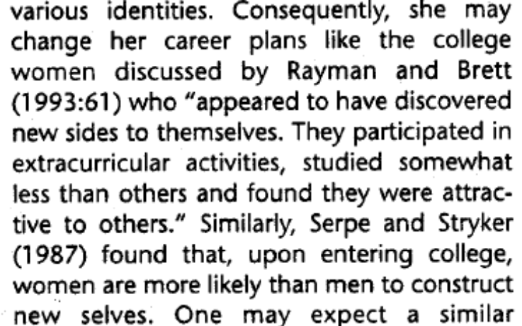
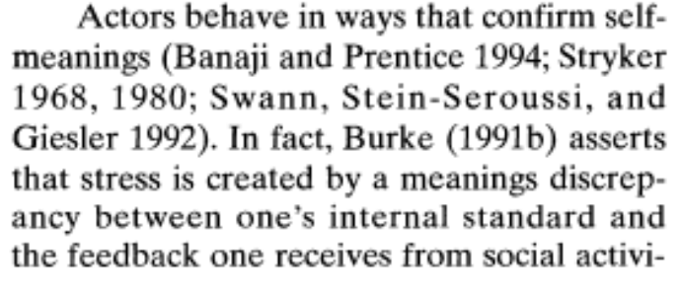
Writing a Research Report
  3. Review of Literature—examples of citing

Slide 18
Writing a Research Report
  Review of Literature
  Note that if you want to explain why social events occur as they do, you will use (and test) explanations that have worked before. THESE EXPLANATIONS ARE CALLED THEORIES.
    Most academic literature reviews have a guiding theory that is used to:
      Frame (or help us understand) facts in the literature.
      Establish expectations (or hypotheses) for the research.
      Justify speculation when no evidence to justify an idea exists in the literature.
    Sometimes the whole point of a research project is to:
      Determine whether a theory works
      Pit two or more theories against each other to see which works better

Slide 19
Writing a Research Report
  Review of Literature
  Quantitative literature reviews typically end with statements of:
    Exactly what the researcher’s specific topic is
    Research hypotheses
      For example:
      “Men will have higher investment income than women even when controlling for education.”
      “Older Americans will oppose abortion for a woman who doesn’t want her baby because she is poor.”

Slide 20
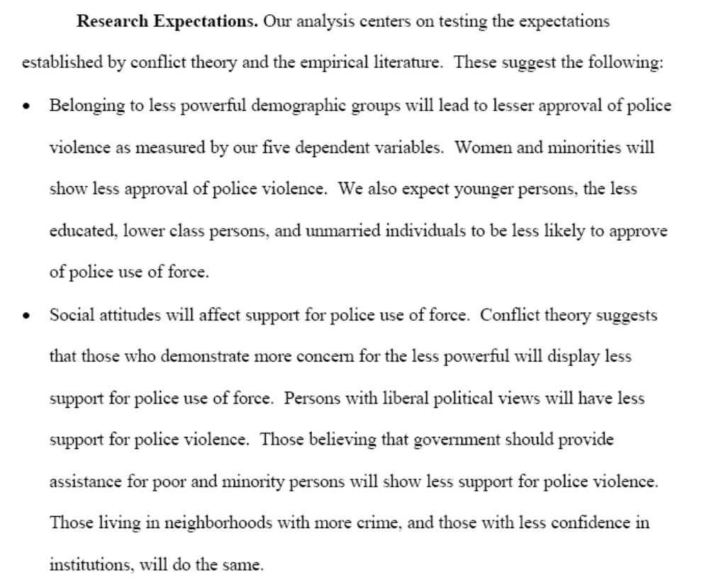
Writing a Research Report
  3. Review of Literature—examples of hypotheses

Slide 21
Writing a Research Report
  Methods
  A METHODS SECTION MUST CONTAIN:
  Descriptions of Data
    Think in terms of: “Who, What, When, Where, Why and How?”
    Target Population
    The Ways Data were Collected:
      Sampling
      Delivery Methods
    Response Rates
    Limitations of Data (Who is omitted, biases)
    Any analyses necessary to bolster claims the data are appropriate
    Sample sizes through various decisions
      Such as:
        eliminating non-Christians from the sample
        using only white respondents

Slide 22
Writing a Research Report
  Methods
  A METHODS SECTION MUST CONTAIN:
  Descriptions of Variables
    Statement of dependent and independent variables
    Names for the variables—make them intuitive!
    Word for word description of the questions. (sociology differs from psychology and medicine here)
    The ways variables are coded

Slide 23
Writing a Research Report
  Methods
  A METHODS SECTION MUST CONTAIN:
  Manipulations of the variables or data
    For example:
      recoding income from 23 uneven intervals to five equivalent categories
      removing non-citizens if studying voting patterns
  Reflection on Adequacy and strength of sample and variables for generalizing to the target population
  The techniques that will be used to test your hypotheses or research questions

Slide 24
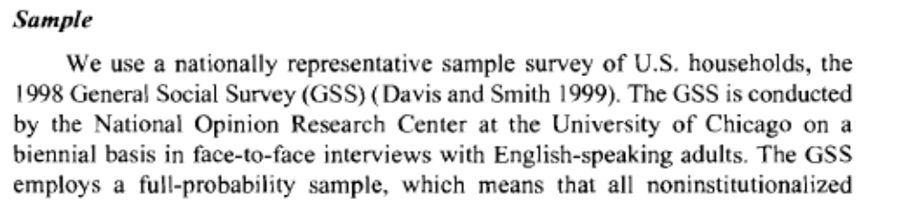
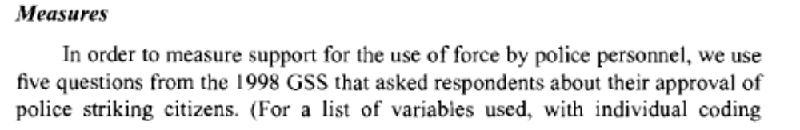
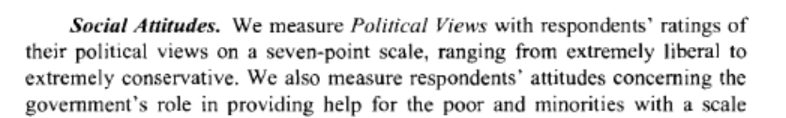
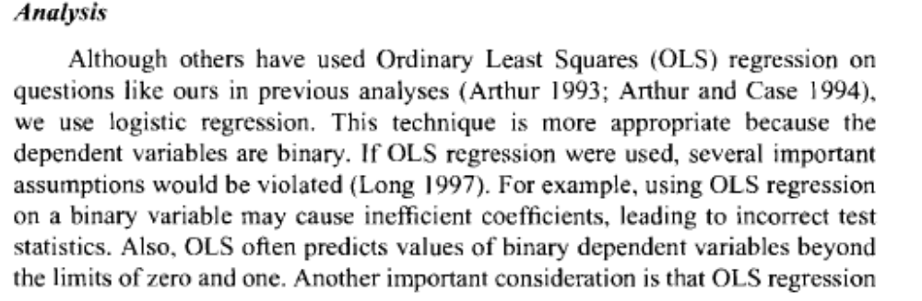
Writing a Research Report
4. Methods

Slide 25
Writing a Research Report
  Results
  The results section chronicles the findings of the statistical analyses and assesses whether your expectations (hypotheses) were correct.

Slide 26
Writing a Research Report
  Results
  The results section includes:
  Professional tables showing descriptive and inferential statistics
  Narrative describing most relevant findings
  The narrative and tables are complementary.
    The narrative discusses ONLY VERY IMPORTANT findings and refers to where information can be found in the tables as different facts are discussed.
    The tables contain almost all statistical information so that the author does not have to write a narrative for every detail in the analysis.

Slide 27
Writing a Research Report
  Results
  The results section includes:
  Evaluations of the hypotheses. Were the research hypotheses supported?
  Statements about new discoveries or surprises encountered in the analyses

Slide 28
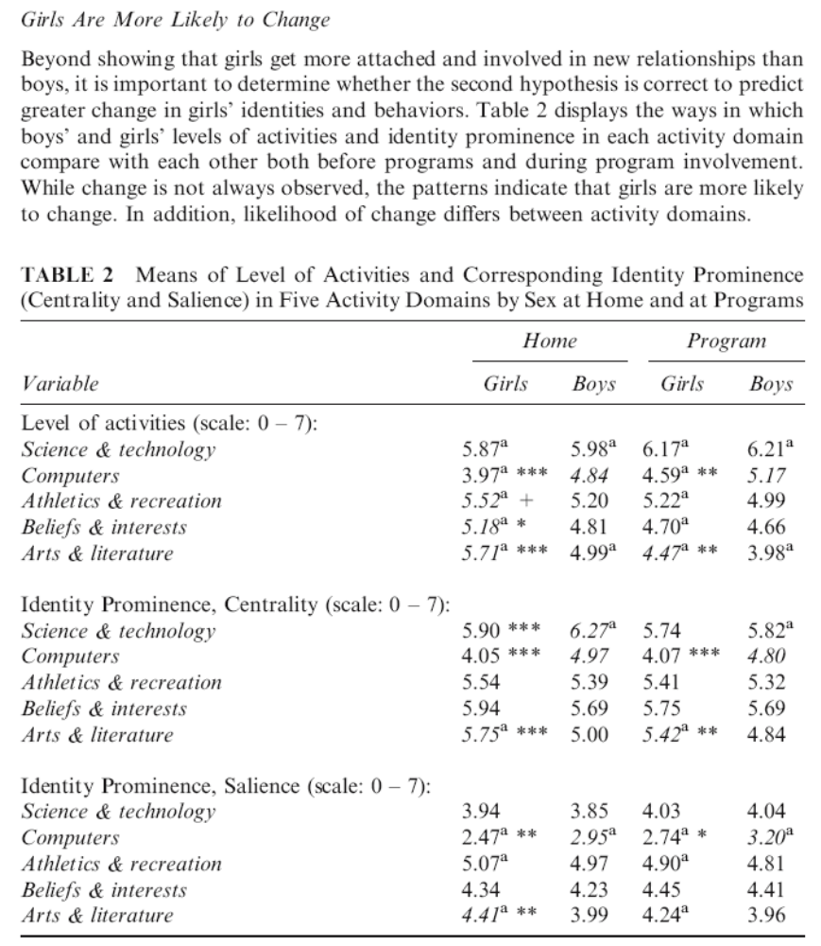
Writing a Research Report
5. Results

Slide 29
Writing a Research Report
  Conclusions and Discussion
  This section assesses how one’s research findings relate to what the community of scholars knew already.
  You should summarize the most salient points of your research (tell the reader what you found out about your topic).
  Discuss the general significance of your topic and findings.

Slide 30
Writing a Research Report
  Conclusions and Discussion
  You should discuss the shortcomings of your study and what implications these have for your findings.
  Discuss things future researchers should investigate about your topic.
  Leave the reader with the understanding he or she ought to have about the topic you spent so much time exploring.

Slide 31
Writing a Research Report
  References
  The references are just as important as any other part of your paper. They are the link to the community of scholars that will permit your reader to assess the worthiness of the claims you make in your paper. References also make the research process much more efficient because they make it very easy to look up sources of facts and ideas.

Slide 32
Writing a Research Report
  References
  Should be hanging indented, alphabetical on author’s last name (by increasing year within same author) with information in order determined by type of source:
  Article
  Last Name, first name. Year. “Article title.” Journal Name Volume: 1st Page- Last Page.
  Lee, James Daniel. 2005. “Do Girls Change More than Boys? Gender Differences and Similarities in the Impact of New Relationships on Identities and Behaviors.” Self and Identity 4:131-47.
  Chapter
  Last Name, first name. Year. “Chapter Name.” Pages in the book in Book Name, edited by first name last name. City of Publisher: Publisher.
  Book:
  Last name, first name. Year. Book Name. City of Publisher: Publisher.

Slide 33
Writing a Research Report
  References
  Should be hanging indented, alphabetical on author’s last name (by increasing year within same author) with information in order determined by type of source:
  A website:
  Last Name (if available), first name. Year (if available). “Article or web page title.” Journal or Report Name Volume (if available). http://address. Date accessed.

Slide 34
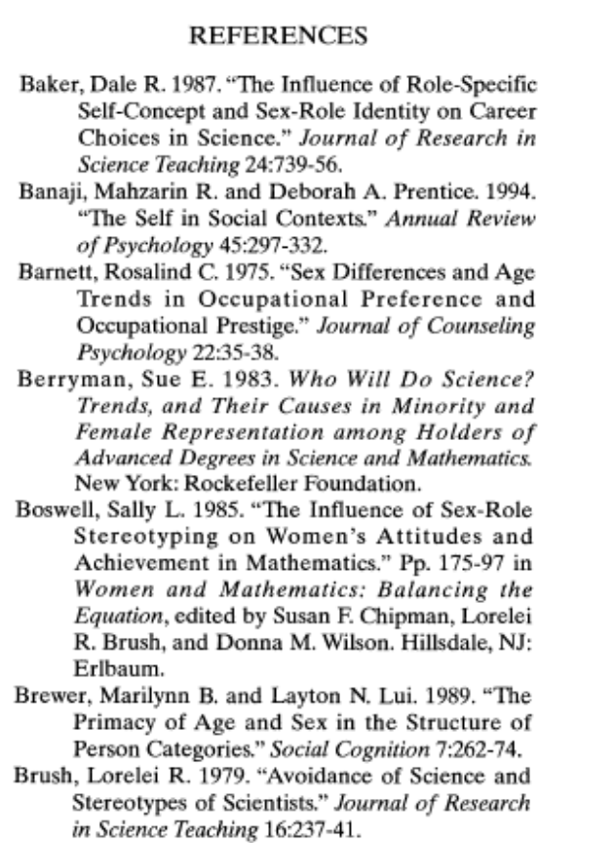
Writing a Research Report
A research report has seven components:
  7. References—an example

Slide 35
Thank you
For listening

